Slide 1

Introduction to Deep Learning
What is a
Neural Network?
deeplearning.ai

Slide 2
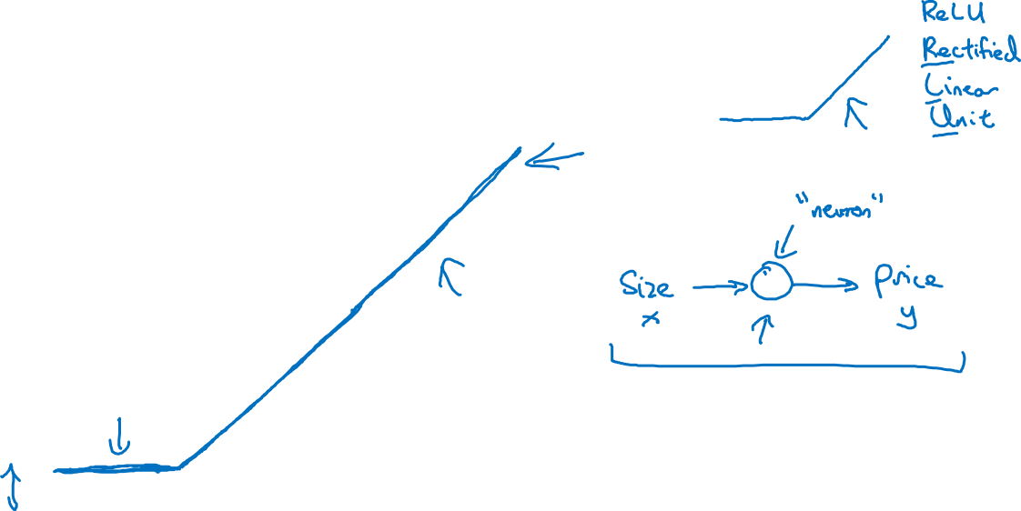
Housing Price Prediction
price
size of house

Slide 3
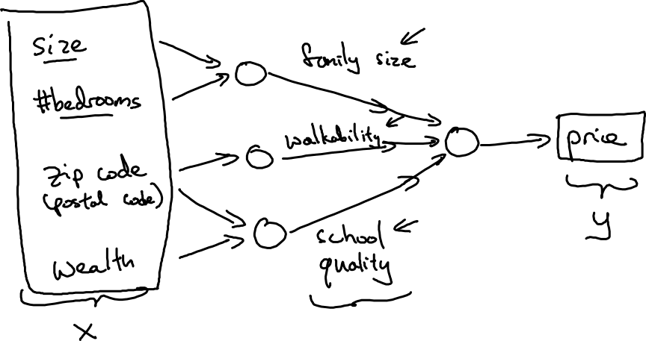
Housing Price Prediction

Slide 4

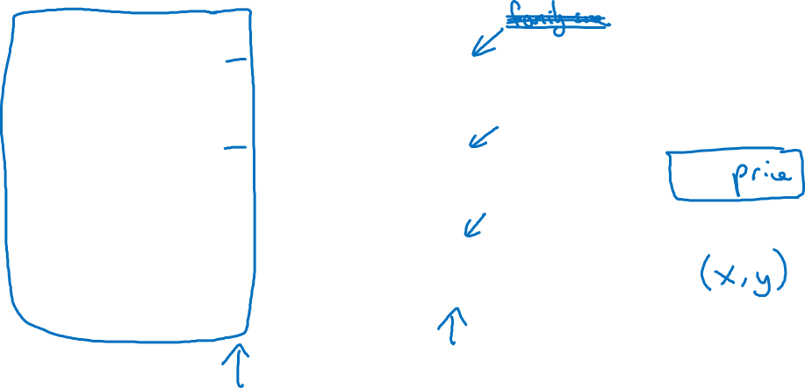
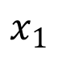
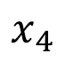
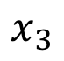
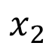
Housing Price Prediction
size
$$x_{1}$$
#bedrooms
$$x_{2}$$
y
zip code
$$x_{3}$$
wealth
$$x_{4}$$

Slide 5
One hidden layer
Neural Network
Neural Networks
Overview

Slide 6
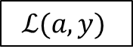
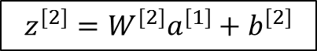
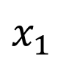
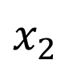
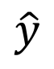
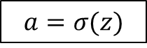
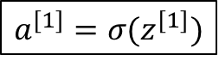
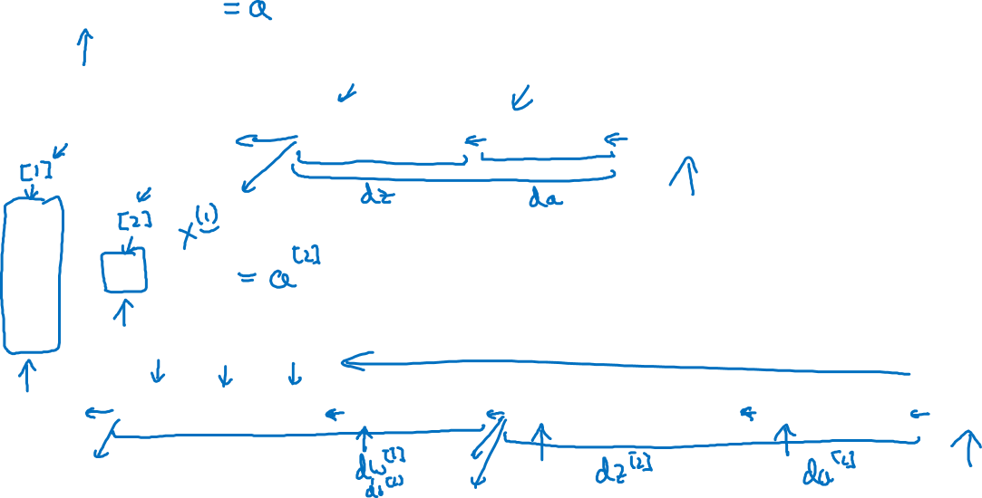
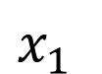
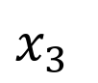
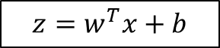
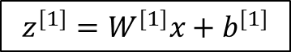

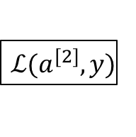
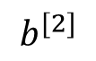
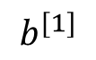
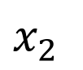
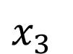
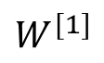
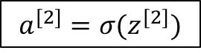
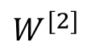
What is a Neural Network?
$$x_{1}$$
$$x_{2}$$
$$\hat{y}$$
$$x_{3}$$
x
w
$$z=w^{T}x+b$$
$$a=σ(z)$$
$$ℒ(a,y)$$
b
$$x_{1}$$
$$x_{2}$$
$$\hat{y}$$
$$x_{3}$$
x
$$W^{[1]}$$
$$z^{[1]}=W^{[1]}x+b^{[1]}$$
$$a^{[1]}=σ(z^{[1]})$$
$$z^{[2]}=W^{[2]}a_{ }^{[1]}+b^{[2]}$$
$$a^{[2]}=σ(z^{[2]})$$
$$ℒ(a^{[2]},y)$$
$$b^{[1]}$$
$$W^{[2]}$$
$$b^{[2]}$$

Slide 7
One hidden layer
Neural Network
Neural Network
Representation

Slide 8
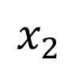
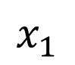
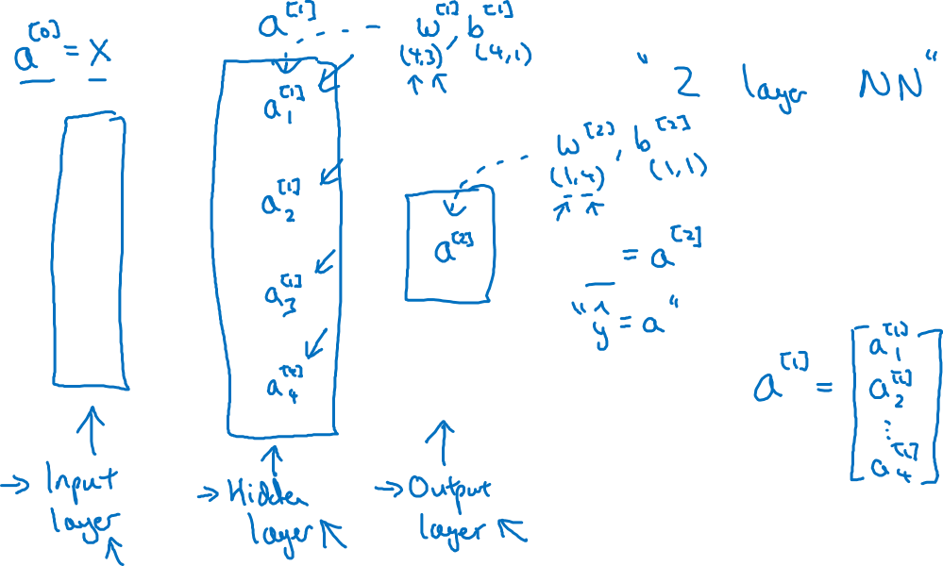
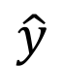
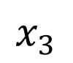
Neural Network Representation
$$x_{1}$$
$$x_{2}$$
$$\hat{y}$$
$$x_{3}$$

Slide 9
One hidden layer
Neural Network
Computing a
Neural Network’s
Output

Slide 10
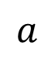
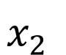

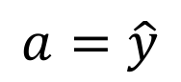
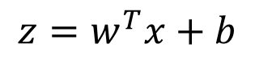
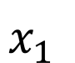
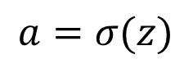
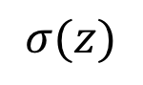
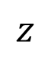
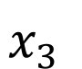

Neural Network Representation
$$x_{1}$$
$$x_{1}$$
$$x_{2}$$
$$σ(z)$$
$$a=\hat{y}$$
$$x_{2}$$
$$\hat{y}$$
$$w^{T}x+b$$
$$z$$
$$a$$
$$x_{3}$$
$$x_{3}$$
$$z=w^{T}x+b$$
$$a=σ(z)$$

Slide 11
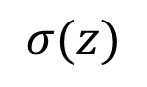
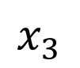
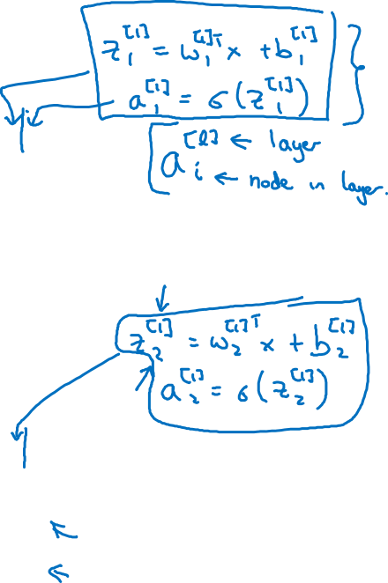
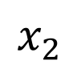
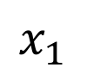
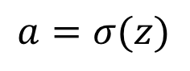


Neural Network Representation
$$x_{1}$$
$$x_{1}$$
$$x_{2}$$
$$σ(z)$$
$$a=\hat{y}$$
$$x_{2}$$
$$\hat{y}$$
$$w^{T}x+b$$
$$z$$
$$a$$
$$x_{3}$$
$$x_{3}$$
$$z=w^{T}x+b$$
$$x_{1}$$
$$a=σ(z)$$
$$x_{2}$$
$$\hat{y}$$
$$x_{3}$$

Slide 12
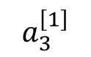
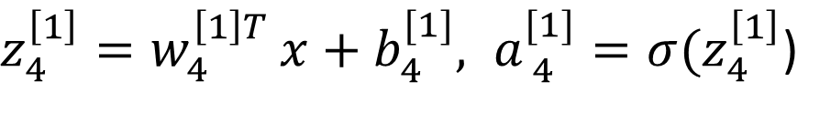
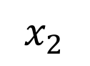










Neural Network Representation
$$a_{1}^{\left[1\right]}$$
$z_{1}^{\left[1\right]}=w_{1}^{{\left[1\right]T}^{ }}x+b_{1}^{[1]}, a_{ 1}^{[1]}=σ(z_{1}^{\left[1\right]}$)
$$x_{1}$$
$$a_{2}^{\left[1\right]}$$
$z_{2}^{\left[1\right]}=w_{2}^{{\left[1\right]T}^{ }}x+b_{2}^{[1]}, a_{ 2}^{[1]}=σ(z_{2}^{\left[1\right]}$)
$$x_{2}$$
$$\hat{y}$$
$$a_{3}^{\left[1\right]}$$
$z_{3}^{\left[1\right]}=w_{3}^{{\left[1\right]T}^{ }}x+b_{3}^{[1]}, a_{ 3}^{[1]}=σ(z_{3}^{\left[1\right]}$)
$$x_{3}$$
$$a_{4}^{\left[1\right]}$$
$z_{4}^{\left[1\right]}=w_{4}^{{\left[1\right]T}^{ }}x+b_{4}^{[1]}, a_{ 4}^{[1]}=σ(z_{4}^{\left[1\right]}$)

Slide 13




$$a_{1}^{\left[1\right]}$$
Given input x:
$$x_{1}$$
$$a_{2}^{\left[1\right]}$$
$$z^{\left[1\right]}=W^{\left[1\right]}x+b^{\left[1\right]}$$
$$x_{2}$$
$$\hat{y}$$
$$a_{3}^{\left[1\right]}$$
$$x_{3}$$
$$a^{\left[1\right]}=σ(z^{\left[1\right]})$$
$$a_{4}^{\left[1\right]}$$
$$z^{\left[2\right]}=W^{\left[2\right]}a^{\left[1\right]}+b^{\left[2\right]}$$
$$a^{\left[2\right]}=σ(z^{\left[2\right]})$$

Slide 14
One hidden layer
Neural Network
Vectorizing across
multiple examples

Slide 15






Vectorizing across multiple examples
$$z^{\left[1\right]}=W^{\left[1\right]}x+b^{\left[1\right]}$$
$$x_{1}$$
$$a^{\left[1\right]}=σ(z^{\left[1\right]})$$
$$x_{2}$$
$$\hat{y}$$
$$z^{\left[2\right]}=W^{\left[2\right]}a^{\left[1\right]}+b^{\left[2\right]}$$
$$x_{3}$$
$$a^{\left[2\right]}=σ(z^{\left[2\right]})$$

Slide 16





Vectorizing across multiple examples
for i = 1 to m:
$$z^{\left[1\right](i)}=W^{\left[1\right]}x^{(i)}+b^{\left[1\right]}$$
$$a^{\left[1\right](i)}=σ(z^{\left[1\right]\left(i\right)})$$
$$z^{\left[2\right](i)}=W^{\left[2\right]}a^{\left[1\right](i)}+b^{\left[2\right]}$$
$$a^{\left[2\right](i)}=σ(z^{\left[2\right]\left(i\right)})$$

Slide 17
One hidden layer
Neural Network
Explanation
for vectorized
implementation

Slide 18

Justification for vectorized implementation

Slide 19

















Recap of vectorizing across multiple examples
for i = 1 to m
$$x_{1}$$
$$z^{\left[1\right](i)}=W^{\left[1\right]}x^{(i)}+b^{\left[1\right]}$$
$$x_{2}$$
$$\hat{y}$$
$$x_{3}$$
$$a^{\left[1\right](i)}=σ(z^{\left[1\right]\left(i\right)})$$
$$z^{\left[2\right](i)}=W^{\left[2\right]}a^{\left[1\right](i)}+b^{\left[2\right]}$$
$$a^{\left[2\right](i)}=σ(z^{\left[2\right]\left(i\right)})$$
$$X=$$
$$x^{(1)}$$
$$x^{(2)}$$
…
$$x^{(m)}$$
$$Z^{\left[1\right]}=W^{\left[1\right]}X+b^{\left[1\right]}$$
$$A^{\left[1\right]}=σ(Z^{\left[1\right]})$$
$$Z^{\left[2\right]}=W^{\left[2\right]}A^{\left[1\right]}+b^{\left[2\right]}$$
$A^{[1]}=$
$$a^{[1](1)}$$
$$a^{[1](2)}$$
$$a^{[1](m)}$$
…
$$A^{\left[2\right]}=σ(Z^{\left[2\right]})$$

Slide 20
One hidden layer
Neural Network
Activation functions

Slide 21







Activation functions
$$x_{1}$$
$$x_{2}$$
$$\hat{y}$$
$$x_{3}$$
Given x:
$$z^{\left[1\right]}=W^{\left[1\right]}x+b^{\left[1\right]}$$
$$a^{\left[1\right]}=σ(z^{\left[1\right]})$$
$$z^{\left[2\right]}=W^{\left[2\right]}a^{\left[1\right]}+b^{\left[2\right]}$$
$$a^{\left[2\right]}=σ(z^{\left[2\right]})$$

Slide 22



Pros and cons of activation functions
a
a
x
z
$$a= \frac{1}{1+e^{−z}}$$
sigmoid:
a
a
z
z

Slide 23
One hidden layer
Neural Network
Why do you
need non-linear
activation functions?

Slide 24
Activation function
$$x_{1}$$
$$x_{2}$$
$$\hat{y}$$
$$x_{3}$$
Given x:
$$z^{\left[1\right]}=W^{\left[1\right]}x+b^{\left[1\right]}$$
$$a^{\left[1\right]}=g^{[1]}(z^{\left[1\right]})$$
$$z^{\left[2\right]}=W^{\left[2\right]}a^{\left[1\right]}+b^{\left[2\right]}$$
$$a^{\left[2\right]}=g^{[2]}(z^{\left[2\right]})$$

Slide 25
One hidden layer
Neural Network
Derivatives of
activation functions

Slide 26
Sigmoid activation function
a
$$g(z)= \frac{1}{1+e^{−z}}$$
z

Slide 27
Tanh activation function
a
$$g(z)=tanh(z){ }$$
z

Slide 28
ReLU and Leaky ReLU
a
a
z
z
ReLU
Leaky ReLU

Slide 29
One hidden layer
Neural Network
Gradient descent for
neural networks

Slide 30
Gradient descent for neural networks

Slide 31
Formulas for computing derivatives

Slide 32
One hidden layer
Neural Network
Backpropagation
intuition (Optional)

Slide 33
Computing gradients
Logistic regression
$$x$$
$$w$$
$$z=w^{T}x+b$$
$$a= σ(z)$$
$$ℒ(a,y)$$
$$b$$

Slide 34
Neural network gradients
$$W^{[2]}$$
$$x$$
$$b^{[2]}$$
$$W^{[1]}$$
$$z^{[1]}=W^{[1]}x+b^{[1]}$$
$$a^{[1]}= σ(z^{[1]})$$
$$z^{[2]}=W^{[2]}x+b^{[2]}$$
$$a^{[2]}= σ(z^{[2]})$$
$$ℒ(a^{[2]},y)$$
$$b^{[1]}$$

Slide 35
Summary of gradient descent
$$dz^{[2]}=a^{[2]}−y$$
$$dW^{[2]}=dz^{[2]}a^{{\left[1\right]}^{T}}$$
$$db^{[2]}=dz^{[2]}$$
$$dz^{[1]}=W^{\left[2\right]T}dz^{[2]}∗g^{[1]}′(z^{\left[1\right]})$$
$$dW^{[1]}=dz^{[1]}x^{T}$$
$$db^{[1]}=dz^{[1]}$$

Slide 36
Summary of gradient descent
$$dz^{[2]}=a^{[2]}−y$$
$$dZ^{[2]}=A^{[2]}−Y$$
$$dW^{[2]}=dz^{[2]}a^{{\left[1\right]}^{T}}$$
$$dW^{[2]}=\frac{1}{m}dZ^{[2]}A^{{\left[1\right]}^{T}}$$
$$db^{[2]}=dz^{[2]}$$
$$db^{[2]}=\frac{1}{m}np.sum(dZ^{\left[2\right]},axis=1, keepdims=True)$$
$$dz^{[1]}=W^{\left[2\right]T}dz^{[2]}∗g^{[1]}′(z^{\left[1\right]})$$
$$dZ^{[1]}=W^{\left[2\right]T}dZ^{[2]}∗g^{[1]}′(Z^{\left[1\right]})$$
$$dW^{[1]}=dz^{[1]}x^{T}$$
$$dW^{[1]}=\frac{1}{m}dZ^{[1]}X^{T}$$
$$db^{[1]}=dz^{[1]}$$
$$db^{[1]}=\frac{1}{m}np.sum(dZ^{\left[1\right]},axis=1, keepdims=True)$$

Slide 37
One hidden layer
Neural Network
Random Initialization

Slide 38
What happens if you initialize weights to zero?
$$x_{1}$$
$$a_{1}^{[1]}$$
$$a_{1}^{[2]}$$
$$\hat{y}$$
$$x_{2}$$
$$a_{2}^{[1]}$$

Slide 39
Random initialization
$$x_{1}$$
$$a_{1}^{[1]}$$
$$a_{1}^{[2]}$$
$$\hat{y}$$
$$x_{2}$$
$$a_{2}^{[1]}$$

Slide 40
Deep Neural Networks
Getting your matrix
dimensions right

Slide 41





Parameters $W^{[l]}$ and $b^{[l]}$
$$x_{1}$$
$$\hat{y}$$
$$x_{2}$$

Slide 42


Vectorized implementation
$$x_{1}$$
$$\hat{y}$$
$$x_{2}$$

Slide 43
Deep Neural Networks
Why deep
representations?

Slide 44



Intuition about deep representation
$$\hat{y}$$

Slide 45
Circuit theory and deep learning
Informally: There are functions you can compute with a “small” L-layer deep neural network that shallower networks require exponentially more hidden units to compute.

Slide 46
Deep Neural Networks
Building blocks of
deep neural networks

Slide 47







Forward and backward functions
$$x_{1}$$
$$x_{2}$$
$$\hat{y}$$
$$x_{3}$$
$$x_{4}$$

Slide 48

Forward and backward functions

Slide 49
Deep Neural Networks
Forward and backward
propagation

Slide 50



Forward propagation for layer l
Input $a^{[l−1]}$
O$utput a^{[l]},$cache ($z^{[l]}$)

Slide 51



Backward propagation for layer l
Input ${da}^{[l]}$
O$utput {da}^{\left[l−1\right]},dW^{\left[l\right]},db^{[l]}$

Slide 52

Summary

Slide 53
Deep Neural Networks
Parameters vs
Hyperparameters

Slide 54
What are hyperparameters?
Parameters: $W^{\left[1\right]} ,{ b}^{\left[1\right] }, W^{\left[2\right]} ,b^{\left[2\right] },W^{\left[3\right] }, b^{\left[3\right] }…$

Slide 55

Applied deep learning is a very empirical process
Idea
cost $J$
Experiment
Code
# of iterations

Slide 56
Deep Neural Networks
What does this
have to do with
the brain?

Slide 57
Forward and backward propagation
For example the first activation functions could be ReLU and the last one
Could be sigmoid
$$Z^{[1]}=W^{[1]}X+b^{[1]}$$
$${dZ}^{[L]}=A^{[L]}−Y$$
$$A^{[1]}=g^{\left[1\right]}(Z^{\left[1\right]})$$
$$dW^{[L]}=\frac{1}{m}dZ^{\left[L\right]}A^{{\left[L\right]}^{T}}$$
$$Z^{[2]}=W^{[2]}A^{[1]}+b^{[2]}$$
$$db^{[L]}=\frac{1}{m}np. sum(dZ^{\left[L\right]},axis=1, keepdims=True)$$
$$A^{[2]}=g^{\left[2\right]}(Z^{\left[2\right]})$$
…
$${dZ}^{[L−1]}=dW^{{\left[L\right]}^{T}}dZ^{\left[L\right]}{g^{′}}^{\left[L\right]}(Z^{\left[L−1\right]})$$
$$A^{[L]}=g^{\left[L\right]}\left(Z^{\left[L\right]}\right)=\hat{Y}$$
…
$${dZ}^{[1]}=dW^{{\left[L\right]}^{T}}dZ^{\left[2\right]}{g^{′}}^{\left[1\right]}(Z^{\left[1\right]})$$
$$dW^{[1]}=\frac{1}{m}dZ^{\left[1\right]}A^{{\left[1\right]}^{T}}$$
$$db^{[1]}=\frac{1}{m}np. sum(dZ^{\left[1\right]},axis=1, keepdims=True)$$
Align left/vertical will mess up the equations here

